Slide 1

LIBRARY DATABASE ANALYSIS
By
AELE PRAVEENA
BANDARI SIREESHA
SIDHRA KHATOON

Slide 2
About me
Background? (B-tech)
Why you want to learn Data Analytics
Any work experience
Share your LinkedIn and GitHub profile URLs
Linkedin : linkedin.com/in/aele-praveena-b06166252
Github : https://github.com/aelepraveena

Slide 3
Agenda
Objective of the Project
ER Diagram and schema explanation
Key analysis questions
SQL query results with screenshots or summaries
Final business insights and recommendations
Conclusion

Slide 4

OBJECTIVE OF THE PROJECT
The main objective of this project is to understand how a library operates by creating and analyzing a complete SQL database.
The project focuses on organizing books, authors, publishers, borrowers, and branch information in a structured way, and then performing SQL queries to study how books are distributed across branches, how borrowers use the library, and how often books are issued.
The goal is to turn raw data into meaningful insights that help improve library management.

Slide 5
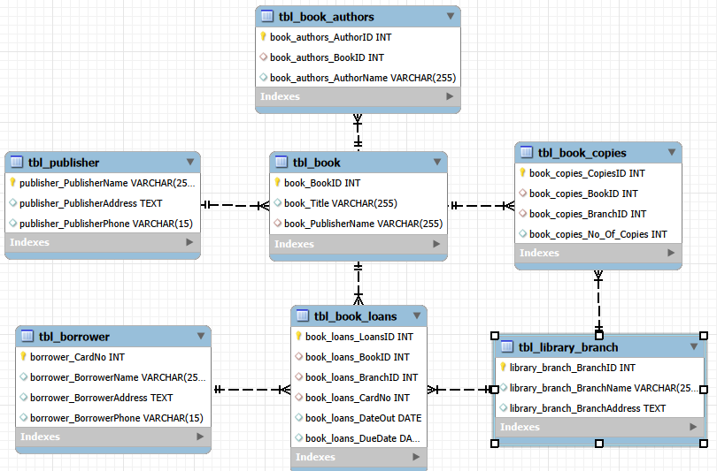
ER Diagram

Slide 6
SCHEMA EXPLANATION
The schema represents the complete relational structure of a Library Management System. It organizes data into 7 related tables, each serving a specific role in managing books, authors, publishers, borrowers, and loan operations.
1. tbl_publisher (Publisher Details):
Stores information about book publishers.
publisher_PublisherName is the Primary Key.
Each publisher can publish multiple books, forming a one-to-many relationship with tbl_book.
2. tbl_book (Book Information)
Contains details about each book in the library.
book_BookID is the Primary Key.
book_PublisherName is a Foreign Key referencing tbl_publisher.
A book can have multiple authors and multiple copies.

Slide 7
3. tbl_book_authors (Authors of Books)
Stores the list of authors for each book.
book_authors_AuthorID is the Primary Key.
book_authors_BookID is a Foreign Key referencing tbl_book.
Supports one-to-many: one book → many authors.
4. tbl_library_branch (Library Branch Information)
Stores each library branch’s name and address.
library_branch_BranchID is the Primary Key.
Each branch can have many copies of books and can issue many loans.
5. tbl_book_copies (Book Inventory Across Branches)
Shows how many copies of each book are available at each branch.
book_copies_CopiesID is the Primary Key.
Contains two Foreign Keys:
book_copies_BookID → tbl_book
book_copies_BranchID → tbl_library_branch
Represents a many-to-many relationship between Books and Branches, resolved through this table.

Slide 8
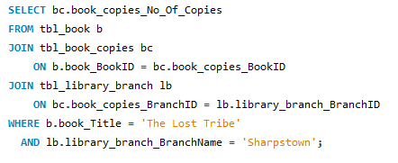

Key analysis questions (use cases)
How many copies of the book titled "The Lost Tribe" are owned by the library branch whose name is "Sharpstown"?

Slide 9
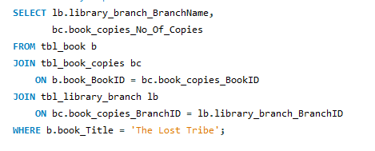
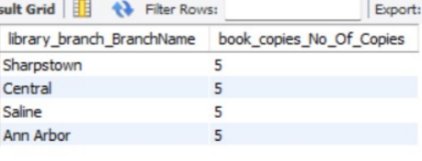
How many copies of the book titled "The Lost Tribe" are owned by each library branch?

Slide 10
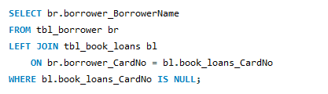
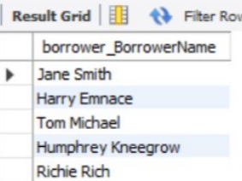
Retrieve the names of all borrowers who do not have any books checked out.

Slide 11
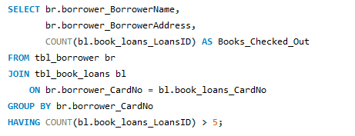
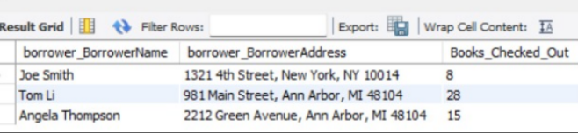
Retrieve the names, addresses, and number of books checked out for all borrowers who have more than five books checked out.

Slide 12
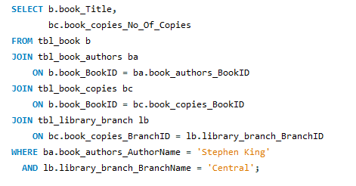

For each book authored by "Stephen King", retrieve the title and the number of copies owned by the library branch whose name is "Central".

Slide 13
Final business insights and recommendations
The library data shows clear differences in book demand across branches, with some branches issuing more books than others.
Certain authors and titles are consistently popular, highlighting the need for better inventory planning.
A small group of borrowers accounts for most of the book loans, while others remain inactive.
Book copies are unevenly distributed, causing limited availability in some branches.

Slide 14
CONCLUSION
This project helped in understanding how a library’s data can be effectively managed using SQL. By building the database and running queries on real datasets, we were able to observe trends in book usage, borrower activity, and branch-level performance. The analysis shows how organized data and structured queries can support better decision-making in daily library operations. Overall, the project demonstrates the value of SQL in managing, analyzing, and improving library services.

Slide 15

THANK YOU

